Slide 1
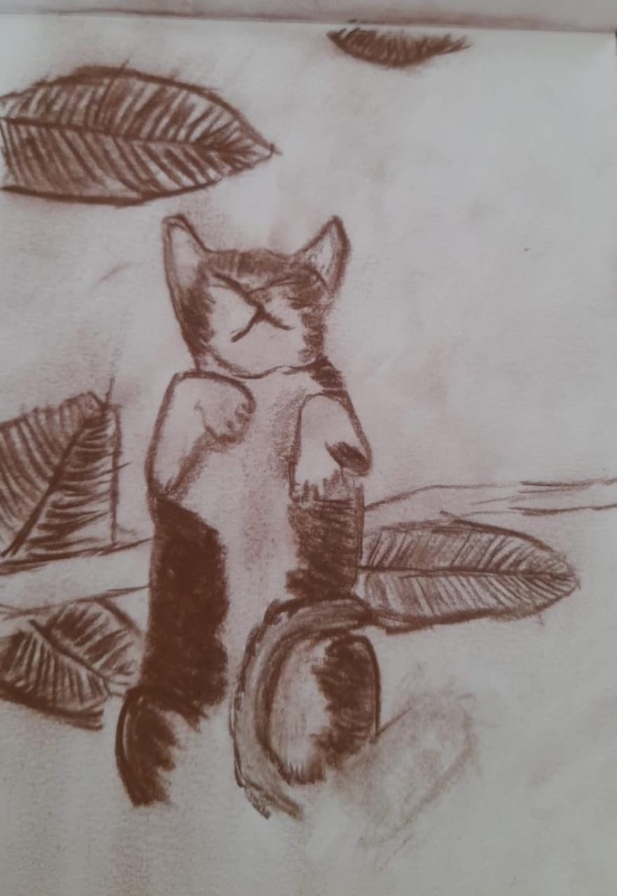
Medium: Charcol on Paper
Size – 8x12 inches

Slide 2
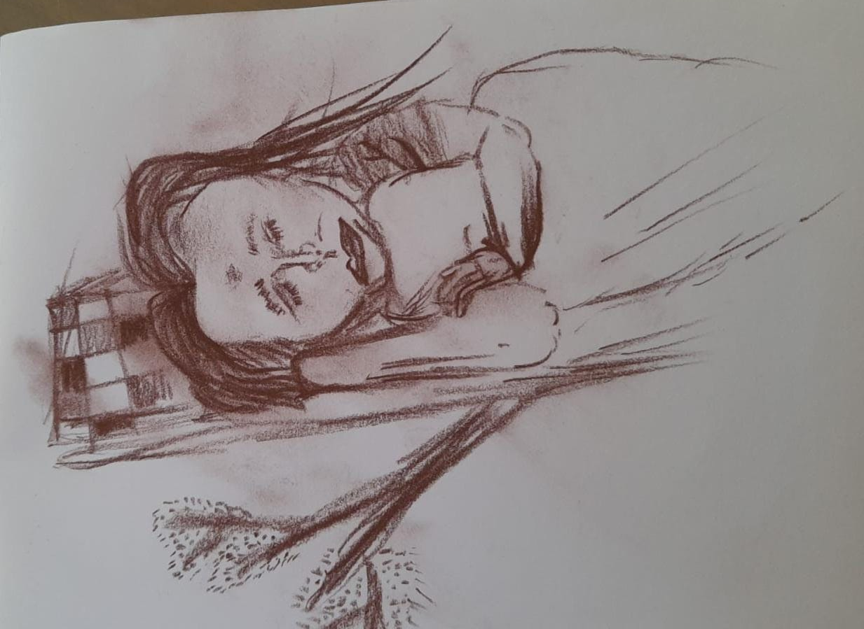
Medium: Charcol on Paper
Size – 8x12 inches

Slide 3
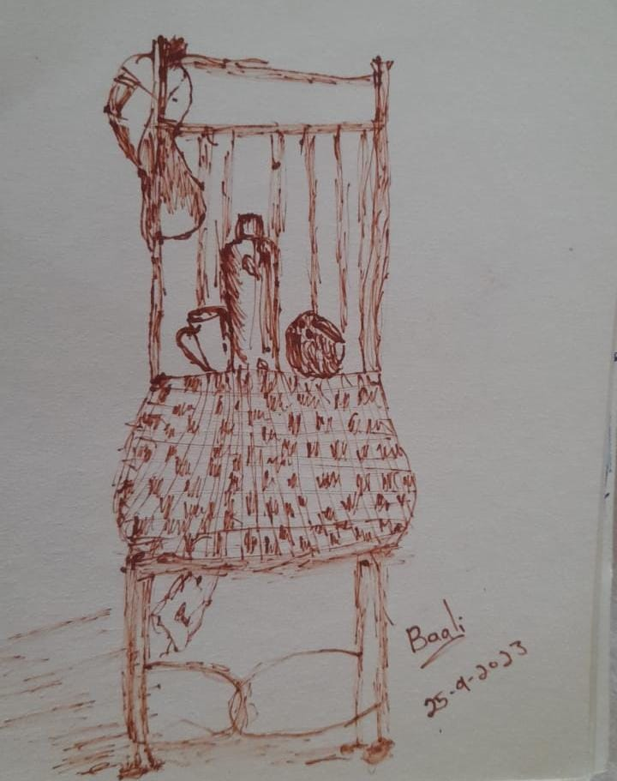
Medium: Pen on Paper
Size – 8x12 inches

